Slide 1
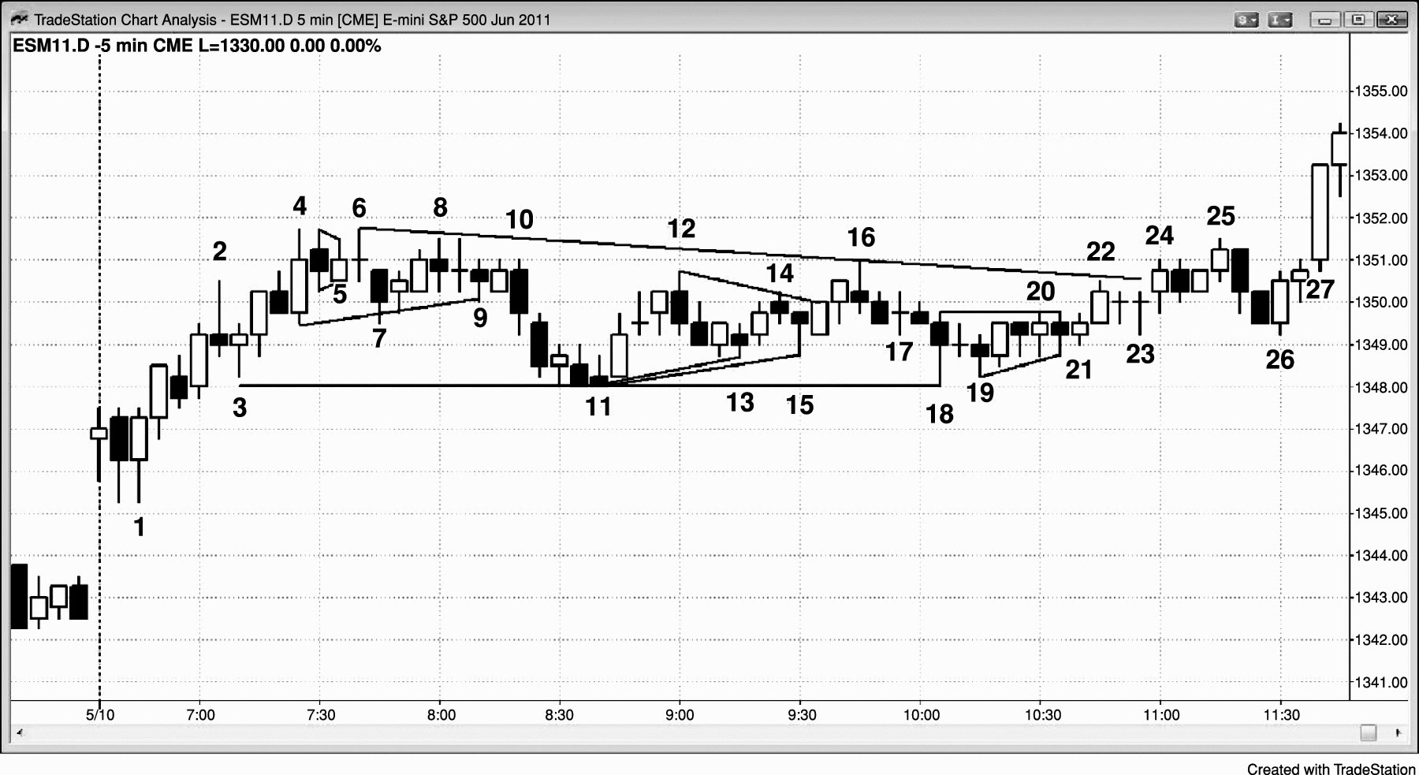
FIGURE 23.1 There Are Many Ways to Draw Triangles

Slide 2
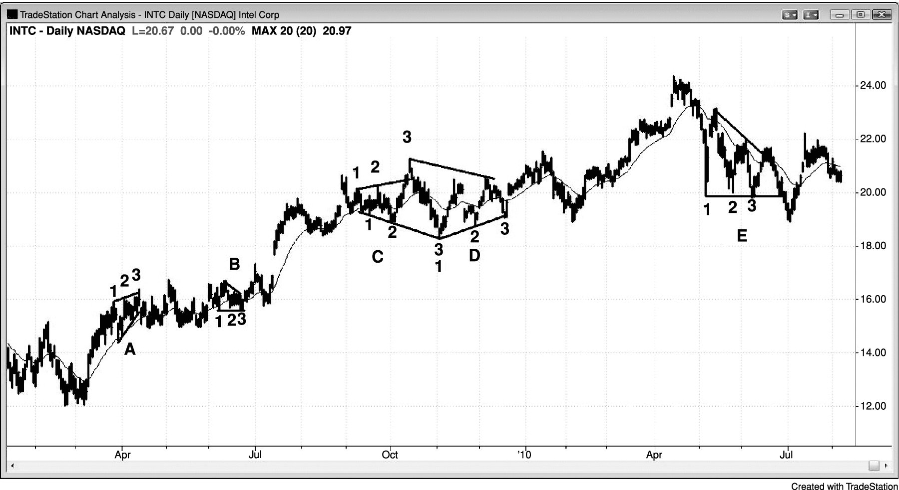
FIGURE 23.2 Triangles

